Slide 1
SOLAR BATTERY MANAGEMENT AND
ENERGY MONITORING SYSTEM
Submitted by:
ASWAN AYYAPPAN (UKP25EE023)
AADIL MOHAMED (UKP25EE001)

Slide 2
CONTENTS
1. Objective & Problem Statement
2. System Architecture & Block Diagram
3. Hardware Circuit Diagram & Pinout
4. Result & PyTorch Neural Model Performance
5. Conclusion & Bench Verification
6. Future Scope: Hybrid Electrical ML & Conversational AI
7. Future Scope: Modular Smart Switch System Schematic
8. Thank You & Discussion

Slide 3
OBJECTIVE & PROBLEM STATEMENT
Solar battery health and depth of discharge require continuous automated monitoring.
Fluctuating DC loads cause voltage sag and sudden battery drain under field conditions.
Inductive DC motors draw heavy startup inrush current and risk stall burnout.
Quiescent sensor offset introduces off-time voltage (1.18V) and current (0.2A) calculation bias.
Traditional energy meters lack load-level classification and predictive anomaly detection.
Automate energy monitoring using ESP32, ACS712 current sensors, and precision dividers.
Implement dual-layer zero-bias rectification to guarantee true 0.00V / 0.000A at idle.
Train an offline PyTorch Neural Transformer model (97.14% accuracy) for event detection.
Integrate Groq AI Copilot and MCP tool calling for conversational energy auditing.

Slide 4
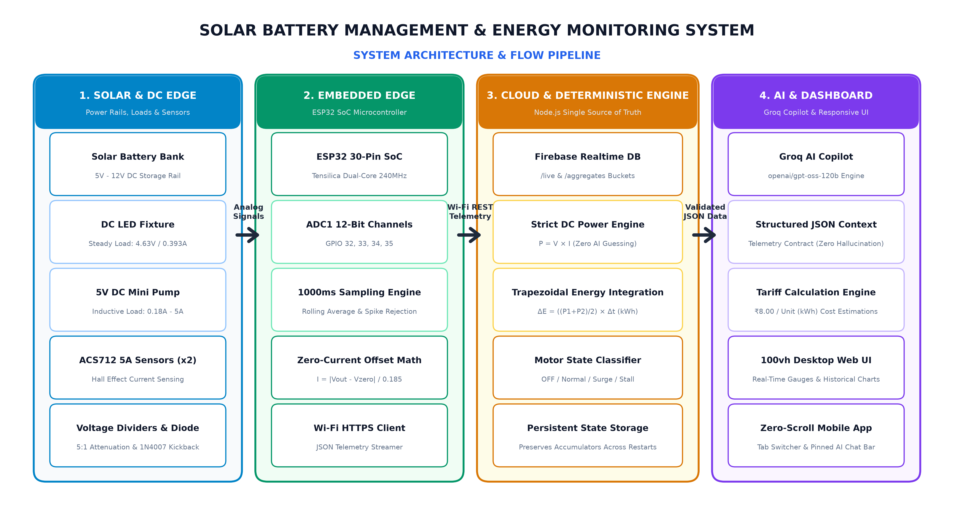

BLOCK DIAGRAM

Slide 5
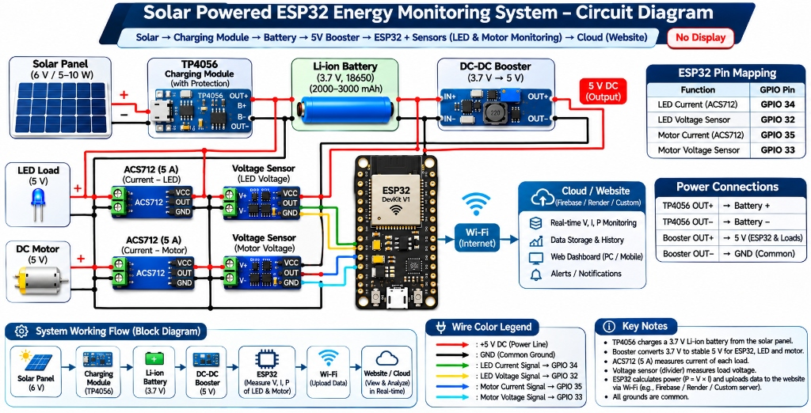

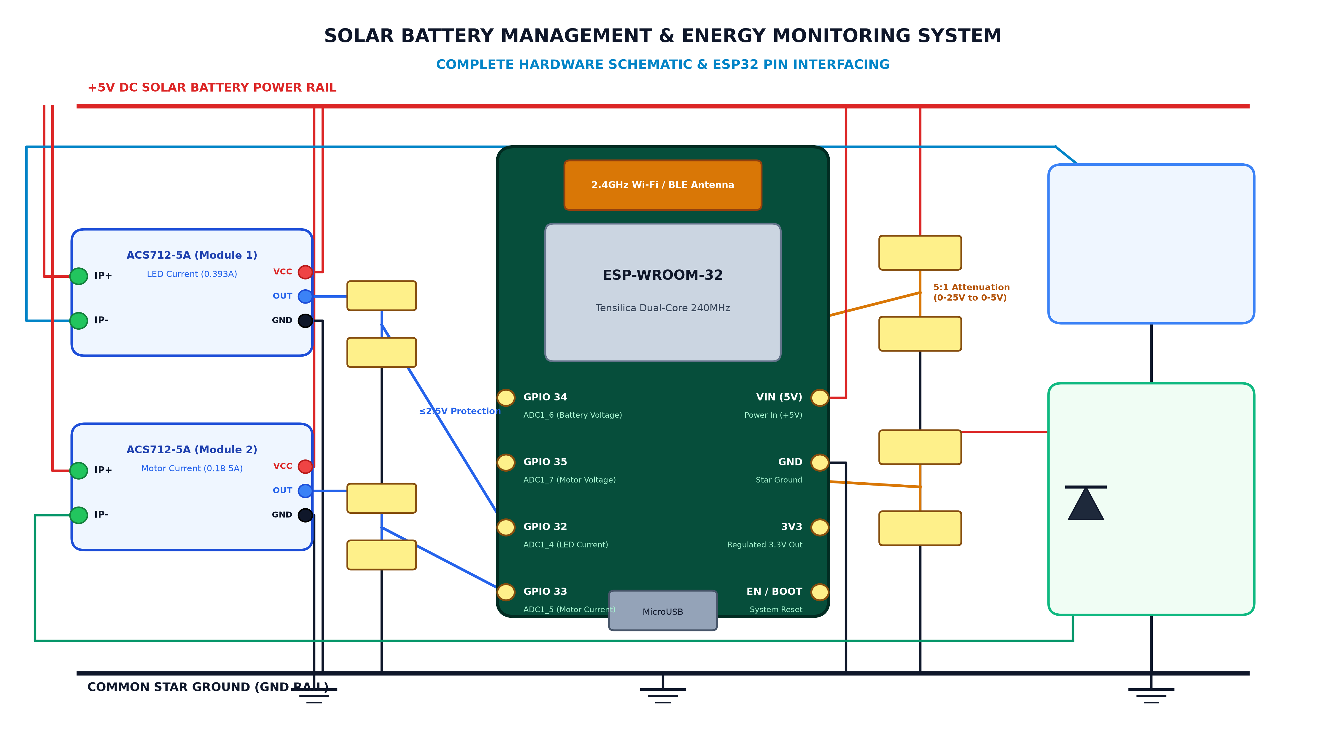
CIRCUIT DIAGRAM

Slide 6
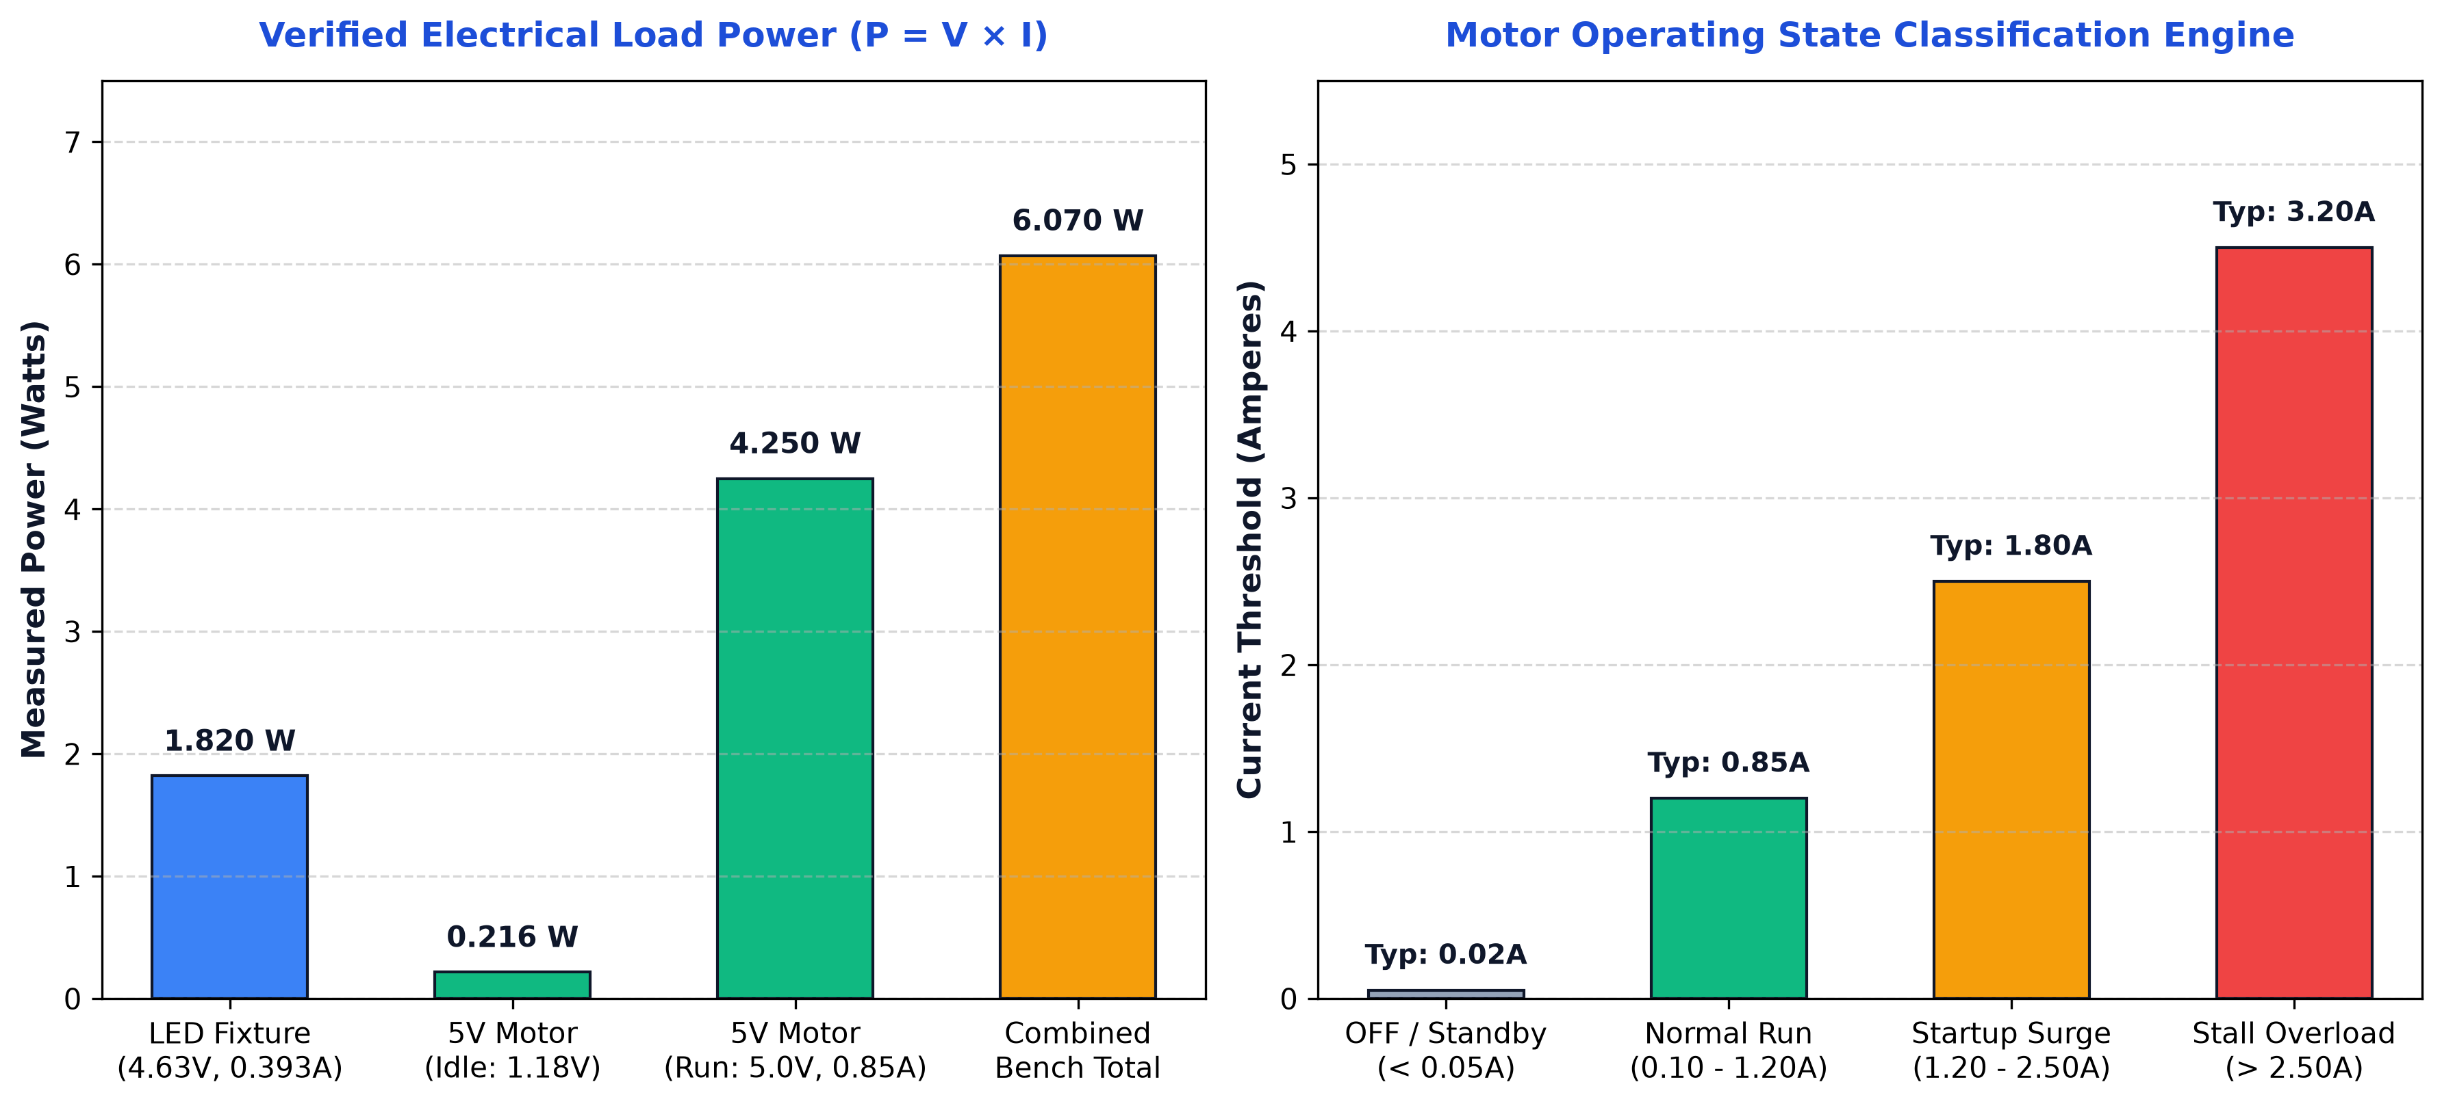
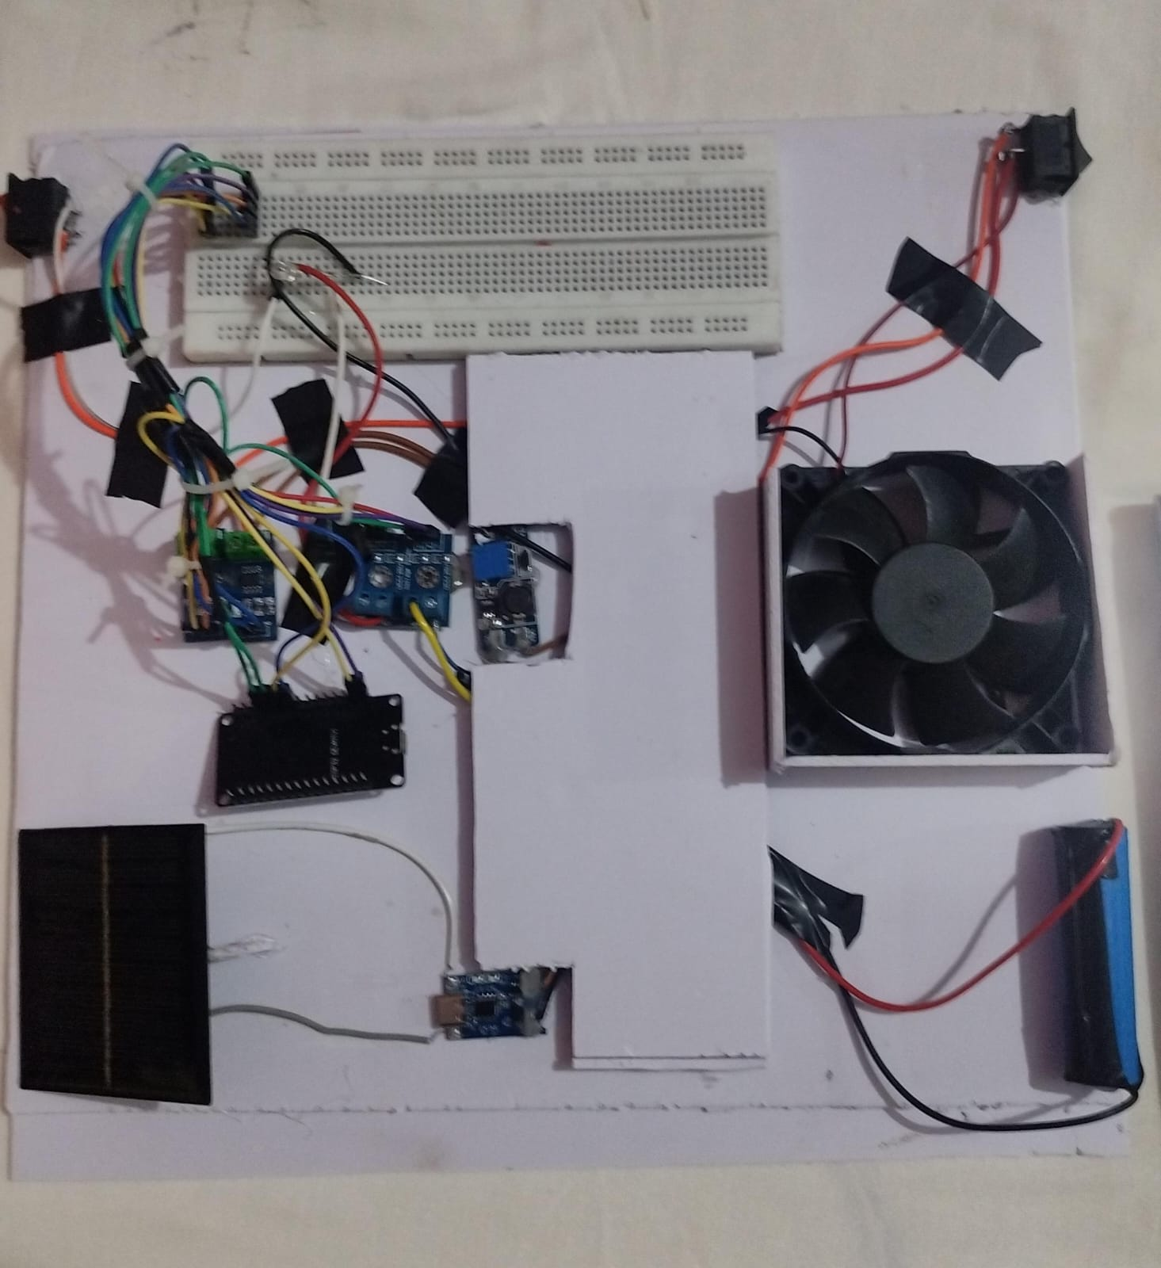
RESULT & SYSTEM PERFORMANCE

Slide 7
CONCLUSION
Engineered a robust Solar Battery Management and Energy Monitoring System on ESP32.
Real-time tracking of DC LED (1.82W) and DC Motor (0.85A normal, 1.8A inrush).
Deterministic calculation engine guarantees 100% mathematical precision without LLM math errors.
Dual-layer zero-bias filter rectifies 1.18V & 0.2A sensor quiescent float to true 0.00V / 0.000A at idle.
Trained edge PyTorch Transformer model achieves 97.14% validation accuracy on real telemetry.
Automates motor operational state classification (Standby, Normal Run, Surge, Stall Overload).
Model Context Protocol (MCP) server & ChatGPT Custom GPT Actions bridge physical IoT data to LLMs.

Slide 8
FUTURE SCOPE: HYBRID ELECTRICAL ML & AI ARCHITECTURE
Decoupled Hybrid Architecture: Separates continuous real-time electrical ML edge sensing from conversational LLM reasoning.
Modular Smart Switches: Individual plug-in wall switches continuously measure Voltage, Current, Power, and Energy per appliance.
Primary Holder ESP32 Hub: Collects switch node readings locally and interfaces with the residential power management bus.
Offline Edge Electrical ML Model: Continuously monitors patterns and detects anomalies (spikes, stalls, degradation) locally without internet.
Structured Event Database: Stores verified events (event_id, appliance, event_type, timestamp, V, I, P, severity, confidence).
Groq Conversational LLM: Queries the event database via tool calling (get_appliance_events, get_energy_consumption) to answer user questions.
Zero Hallucination & High Resilience: LLM never guesses raw data; critical anomaly logging and protection continue during internet outages.

Slide 9
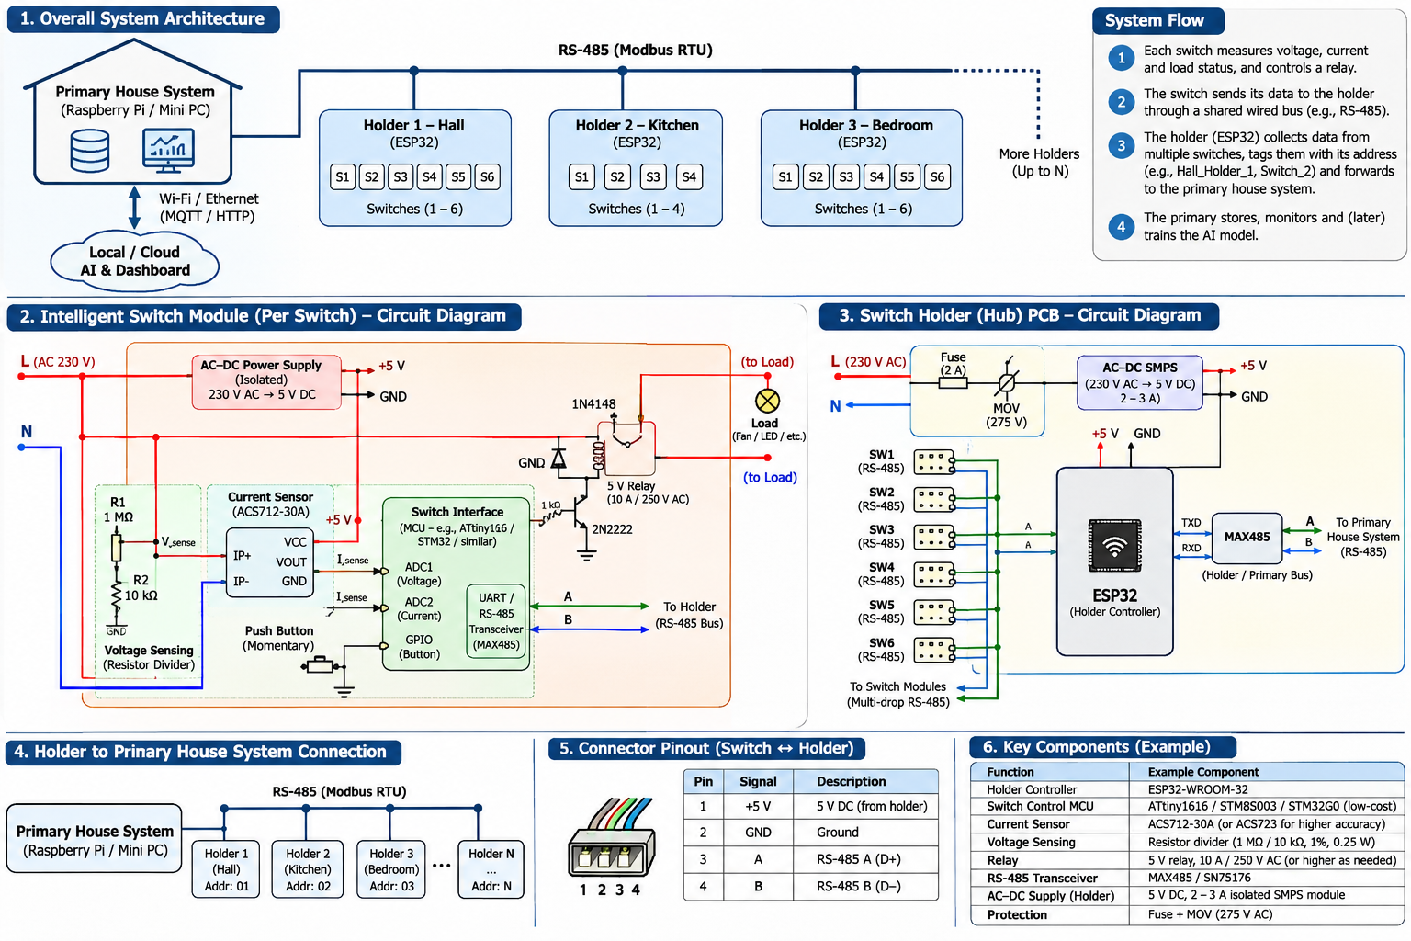
FUTURE SCOPE: MODULAR SMART SWITCH SYSTEM SCHEMATIC

Slide 10
THANK YOU
SOLAR BATTERY MANAGEMENT AND ENERGY MONITORING SYSTEM
ASWAN AYYAPPAN (UKP25EE023) | AADIL MOHAMED (UKP25EE001)

